Slide 1
All About My Project Idea
Likhithanjali Aradadi | 1507973

Slide 2
Smart Inventory Management System

Slide 3
What’s The Project All About?
Smart Inventory Management system is a console based application for tracking the stocks in store.
It makes easy way to track the products, suppliers, customers as well as purchase information.
There are basically two roles , Administrator and Normal user. Both can view the products in store.
Administrator can add items/products to the store which are available in the suppliers products.
Administrator will get the products from suppliers and those will be added to the store.
Administrator can also remove products from store when the customers bought them.
User can login/signup to view the items in the store and purchase them.
Customer purchases , customer data and suppliers information are stored in the database.

Slide 4
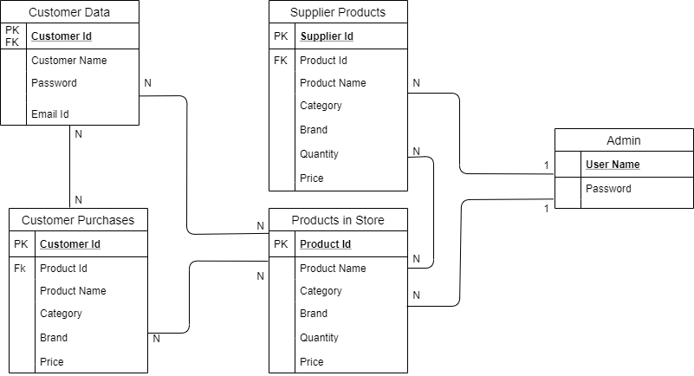
ER/Schema Diagram

Slide 5
Implementation Modules
Module | Concept used to implement the module | Module Finish Date
Login/Sign Up | Encapsulation, Database | Tuesday (14/MM/YY) by 4:00 PM
Supplier | Database | Wednesday (15/MM/YY) by 4:00 PM
Store | Database | Thursday (16/MM/YY) by 4:00 PM
Customer | Database | Friday (17/MM/YY) by 4:00 PM

Slide 6
Input/Output:
INPUT
OUTPUT
Input 1: Add product1 to store
Input 2: Add product1 to customer (when purchase)
Input 3: Remove product from store
Output 1: product added to the store successfully.
Output 2: product added to the customer successfully.
Output 3: product removed from the store successfully.

Slide 7

Thank You

